Slide 1
011 Coursework Guidelines- 2024-25 Tri 2
Dr Andre Samuel
andre.samuel@sam.edu.tt
http://samuellearning.org/scm.html

Slide 2
Requirements for Coursework

Slide 3
Aim
Develop a written consultancy report that provides:
to address the company's operational issues and provide clear recommendations for enhancement.
to define a suitable supply chain strategy for EcoFashion Apparel

Slide 4
Scenario Analysis (30%)
Use either the Porter Value Chain model or the SCOR model to analyse the situation.
Describe the current situation with the given case study, what are their current capabilities for supply chain management, and detail the opportunities for future growth of the company (Perform a SWOT then TWOS and report your TWOS analysis).

Slide 5
Supply Chain Strategies (30%)
Define how the case study organisation could establish a global supply chain, making reference to one supply chain theory such as Porter’s value chain, SCOR model, etc. and the impact on the company structure. The strategies could include references to the following:

Slide 6
Address these items in your Report:
a) Global supply chain operations, i.e., manufacturing, suppliers, engineering centre.
b)Advantages and disadvantages of outsourcing key sections of the supply chain.
c) Identify key supply chain risks and how these risks can be managed.
d) Benefits and disadvantages of Agile vs. Lean vs. Hybrid supply chain strategies.
e) Impact of future technologies in sharing information throughout the supply chain.
f) Impact on future EU fast fashion taxes and reverse supply chains.

Slide 7
Conclusion and recommendations (30%)
Provide a clear set of recommendations defining your ideas how to establish a supply chain, based off your academic research

Slide 8
Report Structure and Content

Slide 9
Report Format
Title Page
Executive Summary
Table of Contents
Body- section 1.0 to 4.0 (see below)
Reference List
Appendices (at your discretion)

Slide 10
Executive Summary
Provide a concise overview of the entire report.
Summarize the key points highlighting:
The main issues EcoFashion Apparel faces
Your recommended strategies.
This should briefly mention the primary findings, conclusions, and proposed solutions to give the reader a clear picture of the report in about 150–200 words.

Slide 11
1.0 Introduction
Discuss the importance of Supply Chain Management
Define supply chain
Brief background into the Sustainable Fashion Industry Supply Chain
What is meant by a sustainable fashion supply chain?
Industry Statistics (market size, major players etc)
Include diagram of the typical stages of a Eco Fashion SC

Slide 12
Give purpose of the report i.e.
Analyse current scenario, capabilities and opportunities
Develop a global supply chain strategy
State the key models and analytical tools that will be used to develop the SC strategy
e.g. Porter’s Competitive Strategies, SCOR model, Competitor analysis, capability analysis, SWOT
Strategic SC Framework Adapted from Santos et al (2021)

Slide 13
2.0 Scenario Analysis
Discuss the purpose of the section i.e.
Objective: Analyse EcoFashion Apparel's current supply chain situation and identify areas for improvement.
Model Choice:
Use either the Porter Value Chain model or the SCOR model to analyse the situation
Perform a SWOT then TOWS and report your TOWS analysis

Slide 14
2.1 EcoFashion Current Situation
Give an overview of EcoFashion Value Chain
Who are their suppliers
What are their operations- manufacturing, design
Who are their customers
Etc.
Include Value Chain Diagram
Use template, Use case study
Include issues in Red font for each activity
Write up findings

Slide 15
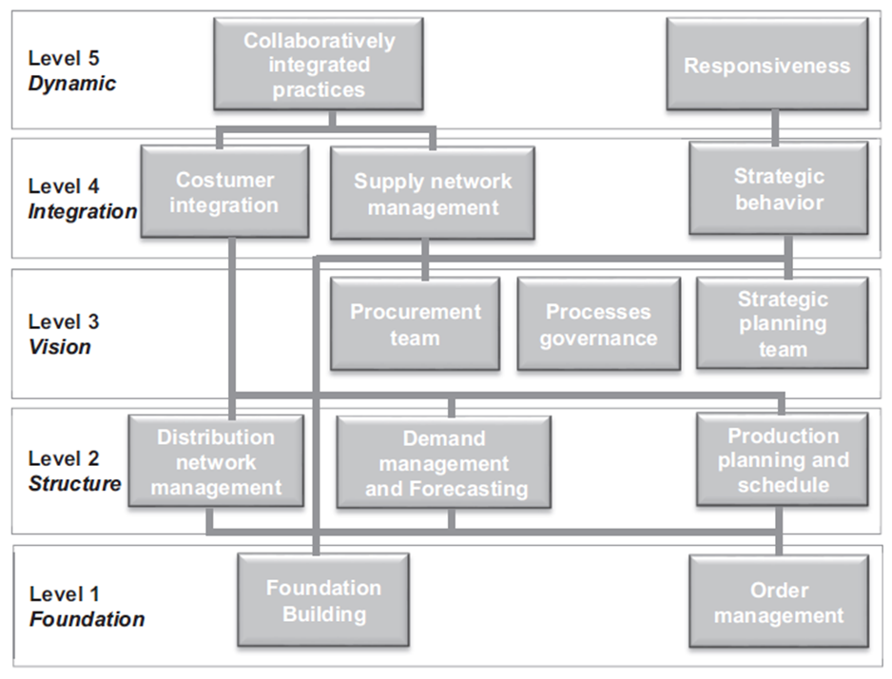
2.2 EcoFashion Capabilities
Based on the literature identify the SC Capabilities required by EcoFashion to implement its SC Strategy
Could use SC Maturity Models e.g. SCPM3 (Oliveira et al. 2011) to identify capability processes
SCPM3 (Oliveira et al. 2011)

Slide 16
Identifying EcoFashion’s Capability Gaps
Use the capabilities identified earlier
Based on the details from case study, rate the capabilities using score 1-5
Evaluate Current State
Identify Gap
Therefore, assess overall SC Maturity Level
Use SCPM3 (Oliveira et al. 2011) Maturity Stages.
Write up findings
Example
Capability | Current State (Score 1-5) 1- Low, 5- High Capability | Gaps

Slide 17
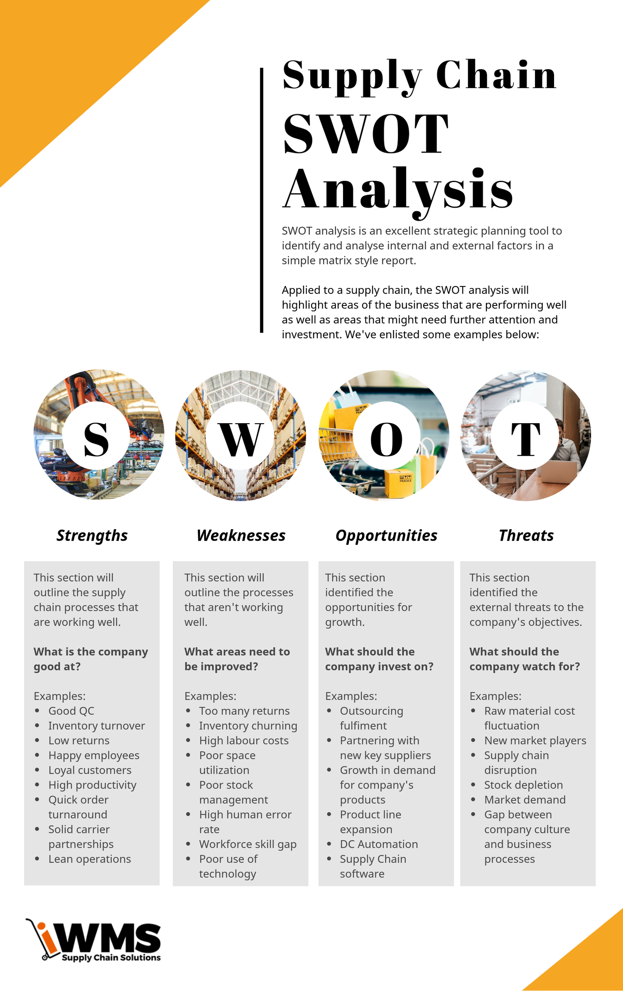
2.3 SWOT Analysis
Present SWOT Analysis/Matrix
2.4.1 EcoFashion Strengths and Weakness
Discuss their strengths and core competencies
Discuss their weaknesses and supply chain issues
2.4.2 EcoFashion Opportunities and Threats
Use case study
Based on further Market Research, Industry trends, findings from PESTLE and Competitor Analysis research (only research, NO documentation)
Discuss potential opportunities
Discuss potential threats

Slide 18
2.4 TOWS Matrix
Use SWOT analysis
Format into TOWS Matrix
Develop and briefly discuss Strategies derived from matching

Slide 19
Useful Case Study
Zara-
https://www.scmglobe.com/zara-clothing-company-supply-chain/
Shien-
https://www.scmr.com/article/how_supply_chain_advantage_has_helped_shein_dominate_cross_border_e_co
https://youtu.be/gWotBPtsulo?si=wZo6-e3nPgQnWC4L
https://ieomsociety.org/proceedings/2024tokyo/55.pdf

Slide 20
3.0 Supply Chain Strategy
Discuss the overall strategy that EcoFashion should use:
Lean or Agile or Hybrid
If Hybrid, identify the de-coupling point in the supply chain
Discuss which type of Postponement will be used
Use and review literature to support your recommendations, build argument, justify design, why?
Draw the recommended Supply Chain Stages, showing what part is lean and agile.
Source: Christopher (2016)
Harrison et al (2008)

Slide 21
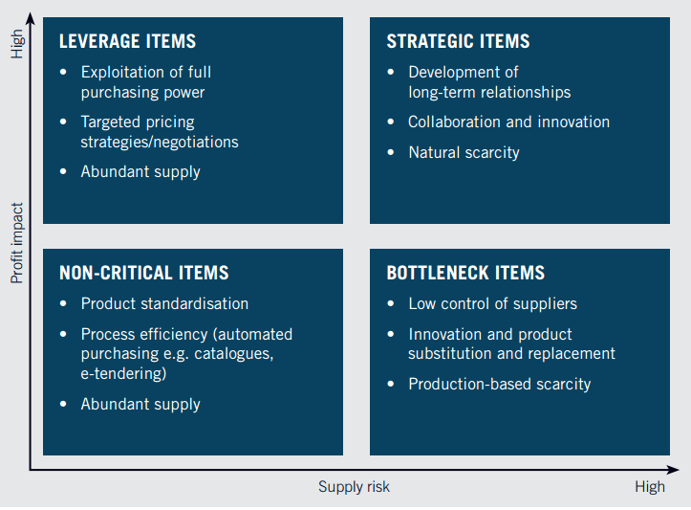
3.1 Sourcing
Make recommendations to resolve supply issues
Discuss the need to implement:
Supply Planning- Fixed list of raw materials e.g. only few types of fabric
Strategic Sourcing
Apply Kraljic Matrix, use Supplier table in case to plot Components onto the matrix
The idea is to develop a tailored portfolio of Suppliers that consists of a combination of responsive and low-cost suppliers
Recommend Diversifying Supplier base
Kraljic, P. (1983) Purchasing Must Become Supply Management, Harvard Business Review, 1983
https://hbr.org/1983/09/purchasing-must-become-supply-management

Slide 22
3.2 Distribution and Logistics
Recommend the establishment of a Global Distribution Network
New/Additional Logistics provider, upgrade to 4PL/5PL for inventory handling and warehousing of finished products
Discuss appropriate Distribution Strategy. Consider:
Use Regional Distribution Centers:
Lima, Peru- to serve North and South American market
Belgium- to serve EMEA market
Singapore or Hong Kong or Malaysia- to serve Asian market
Move Finished goods from factories to RDC’s then onwards to Retail Partners
Using the most efficient multi-transport mode
Consider Outsourcing of RDC’s
Recommend the use of Cross Docking at RDC’s

Slide 23
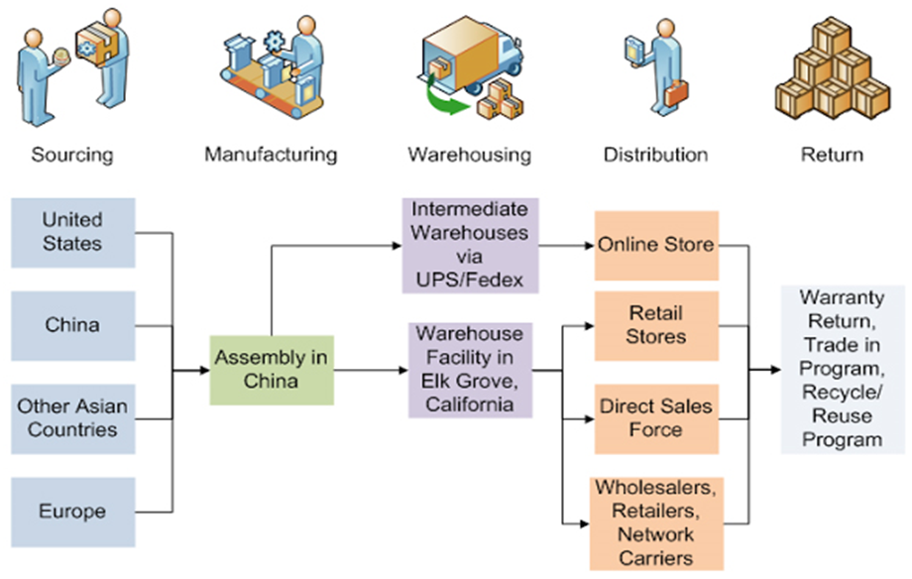
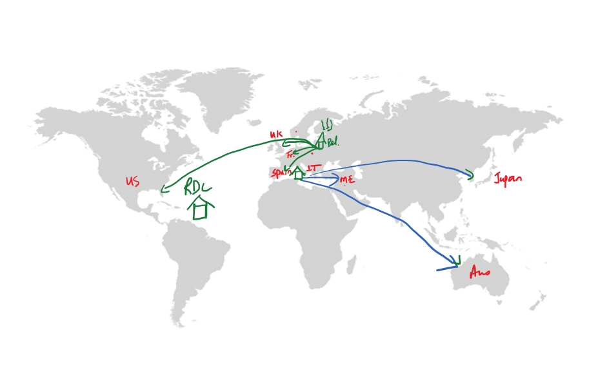
3.3 Global Supply Chain Network
Now, given above recommendations;
Discuss EcoFashion's manufacturing locations, suppliers and the benefits of a global supply chain.
Highlight areas where global operations could enhance efficiency, cost savings, or resilience.
Disaggregating their Value chain:
Outsource the lower value creating activities e.g. Contract Manufacturers,
Keep inhouse the high value creating activities e.g. Design, marketing
Using a World map, visualize the Global SC

Slide 24
3.4 Implementing Future Technologies
Discuss need for creating an integrated SC and to facilitate SC Collaboration to share information
Recommend a Digital Supply Chain
Recommend Use of Industry 4.0 Technologies e.g. AI, Machine Learning, Big Data for Visibility, Market Sensing etc.
Explain the role of these technologies in promoting sustainable practices.
Recommend solutions from the potential technology options listed in the case, stayed within $1M budget.
Provide options that will support the company’s strategic objectives.

Slide 25
3.5 Regulatory Impact
Explore the implications of fast fashion taxes i.e. how regulations may affect their supply chain
Recommend the necessity for EcoFashion to develop reverse logistics systems.
Discuss the concept of Reverse Logistics and creating a Closed loop
Discuss how Returns from clients will be handled e.g. collections at retail partner stores
Debate and recommend whether to outsource to 3PL or handle reverse logistics in-house

Slide 26
3.6 Sustainable Supply Chain
Suggest practical steps EcoFashion can take to improve sustainability, such as eco-friendly materials, circular supply chains, or waste reduction initiatives
Include model to support your recommendations
Theoretical Framework of Green Business Value Chain (Hasan et al 2019)

Slide 27
3.7 Supply Chain Risk Management
Identify and discuss possible risk EcoFashion will encounter by going Global
Use Risk identified in the case plus others (max 7 risks)
Assess these risks, build a table
Discuss mitigation strategies
Could add to table as a new column

Slide 28
4.0 Conclusion
Provide a summary of key findings from Scenario Analysis
Give a summary of key recommendations made for:
Sustainability
Operational Efficiency
Technological Investments

Slide 29
Reference List
List all sources used, including academic references, industry reports, and case studies.
Follow the specified Anglia Ruskin Harvard Referencing style

